Slide 1


“Demonstrating that you’ve taken account of a consultation: Using RQDA to analyse texts and emails.”
Oxford R User Group
Dr Douglas Campbell
4th March 2019

Slide 2
Outline
Acknowledgments
1. The Problem
2. An overview of RQDA
a. Coding texts
b. Extracting those codes
3. A personal summary
4. How RDQA was used
5. RQDA v Tidytext
6. Questions

Slide 3
Acknowledgements
RQDA author: Ronggui Huang
Website: http://rqda.r-forge.r-project.org/
RQDA videos on Youtube: Metin Caliskan
Notes:
Huge debt to these two,
one for the code,
the other for the videos (in English or French)
NB Code updated 2018
Good RQDA email list too for Q&A

Slide 4
1. The Problem
The Policy: re-introduce charges for collecting green waste
The legal context: Councils must consult those affected or who may be affected (S.3 Local Government Act 1999)
A consultation is not a referendum
Notes:
The real challenge was: how to show that the politicians had taken into consideration the views of hundreds of residents
NB the proposal affected over 60,000 residents

Slide 5
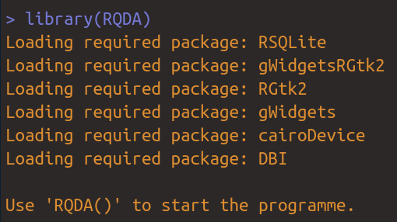
2 An overview of RQDA
Loading the package
Notes:
Pay attention to the dependencies, may need to do some work to download all these and install them.

Slide 6
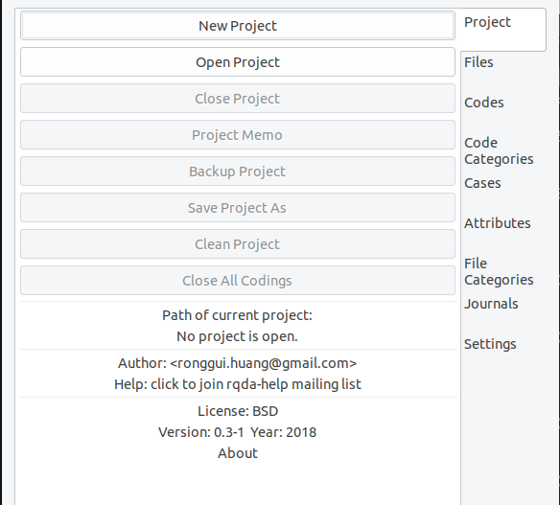
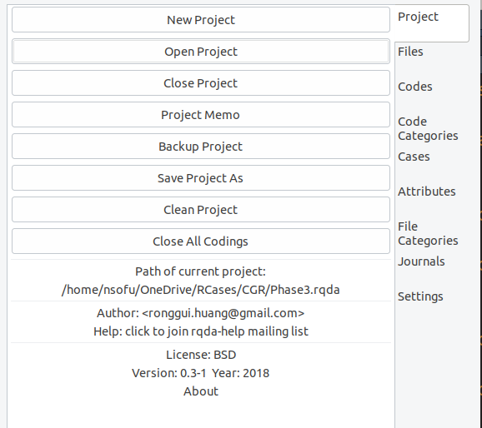
The main menu
Notes:
Note that you need to open a project.
See on the right how all the options that were grey are now black
Always save frequent backups.
No backwards arrow or equivalent key
Note path name changes when you open it
Project memo – your project documentation
two methods to add – from menu or type (cut and paste)

Slide 7
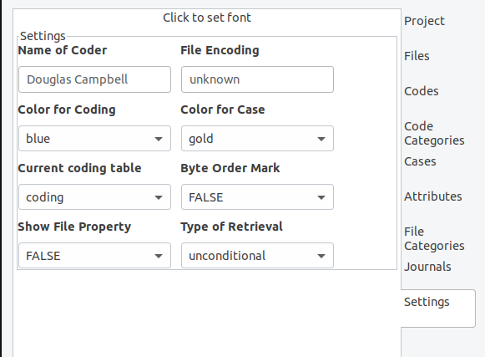
Adjust settings
Notes:
Change the font
Set the coder (useful for collaborative work)
Change the colours, if you wish to.
File encoding – may help to set in to UTF-8 if you and your collaborators use different machines, especially if you mix Mac and Windows
Note the Type of Retrieval menu, we will come back to that

Slide 8
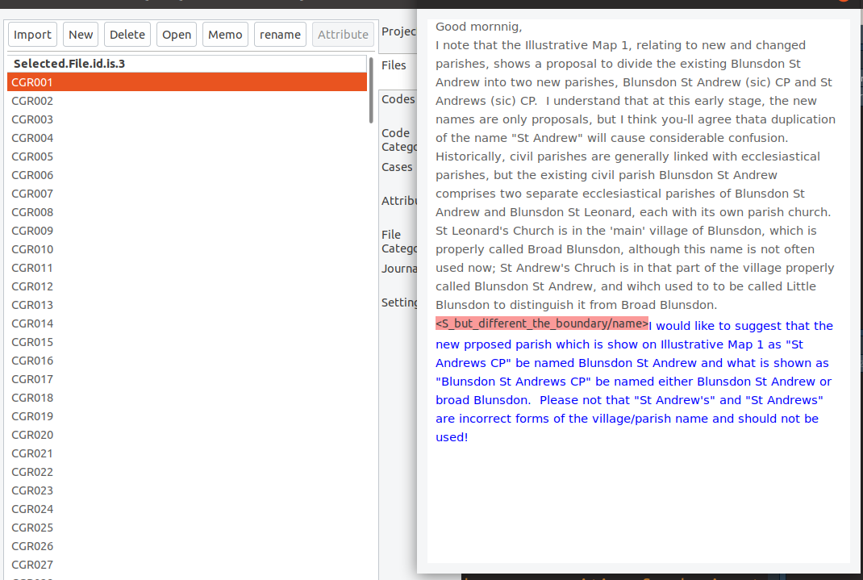
Files
Notes:
Reads text files, or you can copy and paste in a new one, or you can type directly.
Double click or click open to read one.
Note you can rename or assign to defined attributes.
NB attributes, like codes, file categories and cases are just a means of setting identifiers to allow subsetting of data later.

Slide 9
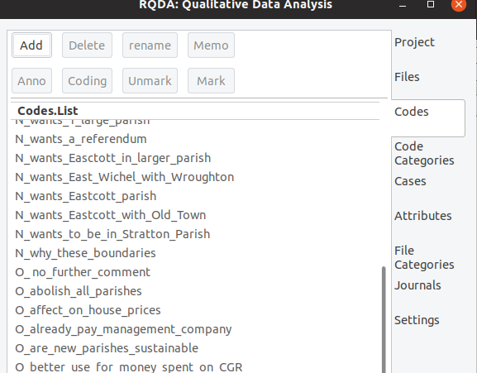
Codes, Categories, Cases, etc.
Notes:
Recommend you start with a list but you can build as you go along.
Go to file, open up a text, then go to codes, highlight and choose code with Mark button
Each code is like a highlighter with a unique colour.
Recommends underscore rather than a space and to accents.
Coding button shows all text with that code number is the character position not the line
This is qualitative, this does take time.
You can write a memo about the code, to explain what you were trying to measure
annotation only applies to part of the text – use it to explain technical terms, acronyms, foreign words.
Right click on a code to show options to display coding lists, memos, etc. within the gui – will come back to categories
Key tip: code whole sentences or paragraphs if you want to automate view x occurred often with view y. I didn’t and lost a good opportunity to show more.
NB If you are being scientific – 2 coders, use Cronbach’s alpha UK GE 2005 media study?
Export codes
use to give samples to illustrate views – cut outs, speech bubbles – export as HMTL
can export more than one code at one time – just click on the ones you want
NB my code names help sort the codes to allow this
Journal
UK a diary – just what you did, when you did, that sort of thing – a record of what you did, not the same as a memo

Slide 10
Codes, Categories, Cases, etc.
A worked example
“Wow, what a good idea!”
Notes:
How to code this
NB, on the face if it, this is praise – only one exclamation mark.
BUT hardly anyone ever praises a proposal
YET apart from intuition, cannot say that it is negative. It could be a black swan
Create a new code
A_could be praise
Add a category

Slide 11
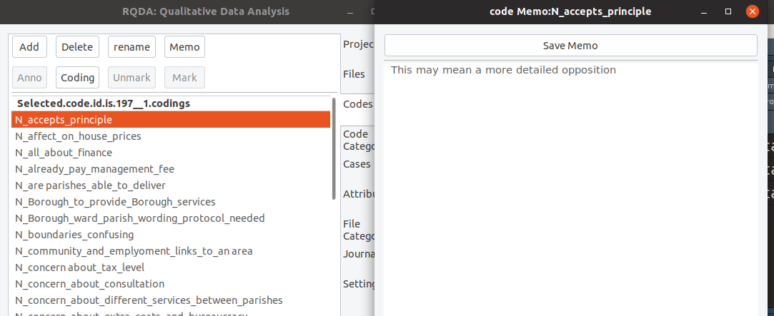
Memos with (almost) everything
Notes:
Just to note any context, special details, built in post it notes

Slide 12
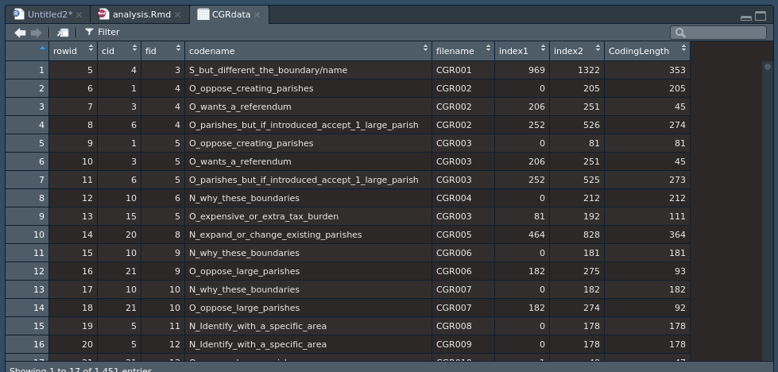
The Output

Slide 13
R script to get output
library(RQDA)
library(tidyverse)
#
#go into RQDA,open the project you need
#
CGRdata<-getCodingTable()
casesCodedBy
Get cases coded by specific codes, by specifying the code Ids.
See documentation for more.
Notes:
There is automated coding codingBySearch
Auto-coding by pattern matching but you have to be very precise about the pattern
crossCodes(relation=c("overlap","inclusion","exact","proximity"),codeList=NULL,
data=GetCodingTable(),print=TRUE,...)
crossTwoCodes(cid1,cid2,data,relation=c("overlap","inclusion","exact","proximity"),…)
Key point; the better your codings, the more you can use the different options to extract by code, by file, by file category, you are just interrogating a database.

Slide 14
3. A Personal Summary
Negatives
A bit “clunky” - does not look as good as current Office products
It is time consuming (but so is any manual mark-up system)
Positives
It works as a research tool, both for coding and for noting what you were doing and why you did it.
It extends R into qualitative analysis
Notes:
These are just my personal observations.
No automating back up – use backups from opening menu often.
Have to click on save otherwise you lose what you just entered.
I would endorse this package

Slide 15
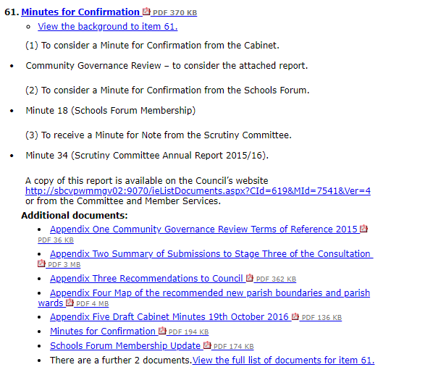
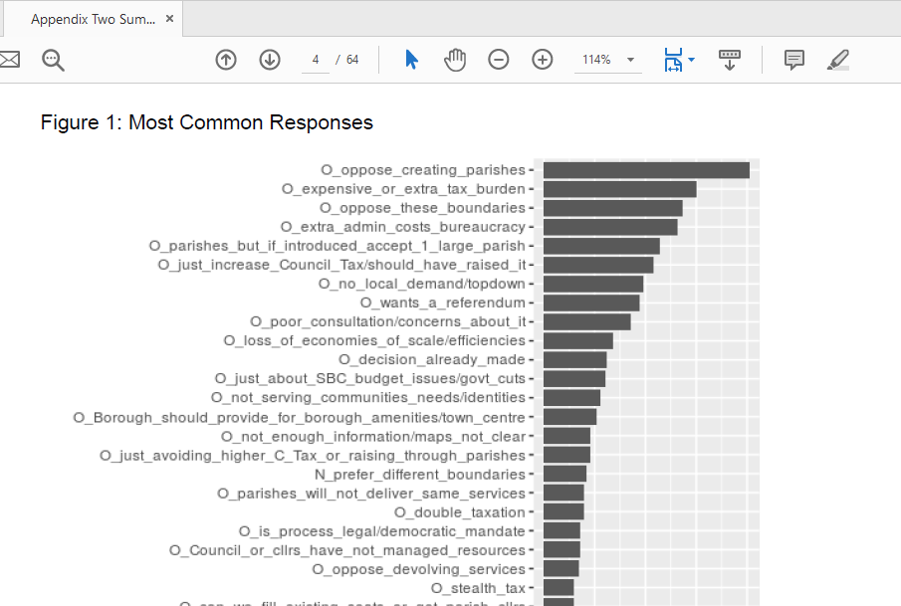
4. How RQDA was used
Full Council, 10th November, 2016
https://ww5.swindon.gov.uk/moderngov/ieListDocuments.aspx?CId=284&MId=7446&Ver=4
Notes:
This is the real life document.
It was used once at a Members’ only briefing. Followed within 24 hours by an FOI about how the research was being done.
Most important of all, the decision was not challenged over the consultation, just the politics.

Slide 16
5. RQDA v TidyText
TidyText is great when you are focusing on the individual words or tokens.
RQDA is best when you want to breakdown sentiment and comments into distinct concepts.
Notes:
These are complementary tools rather than alternatives.
RQDA is well-designed for field research.

Slide 17
Any Questions?

